Slide 1
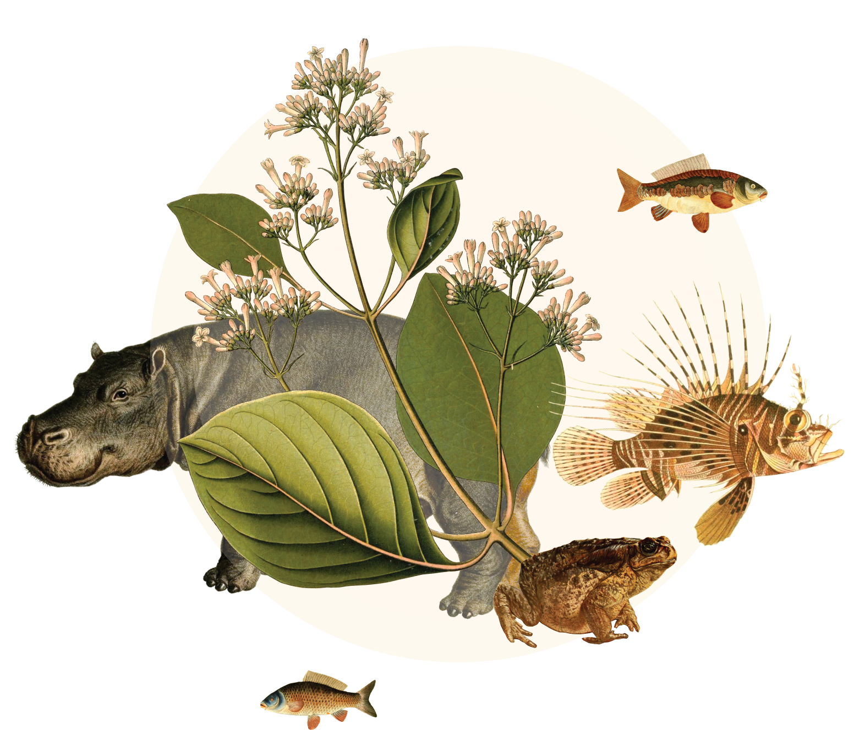
Invasive
species
gbif.org/invasives
Notes:
Text from postcard:
The introduction of invasive species to new ecosystems can have profound impacts on both biodiversity and human well-being. GBIF is a vital resource for users seeking to discover, access, and use data on invasive species worldwide, providing a single entry point that can help bridge the gap between scientific knowledge and practical solutions to invasive species challenges.

Slide 2
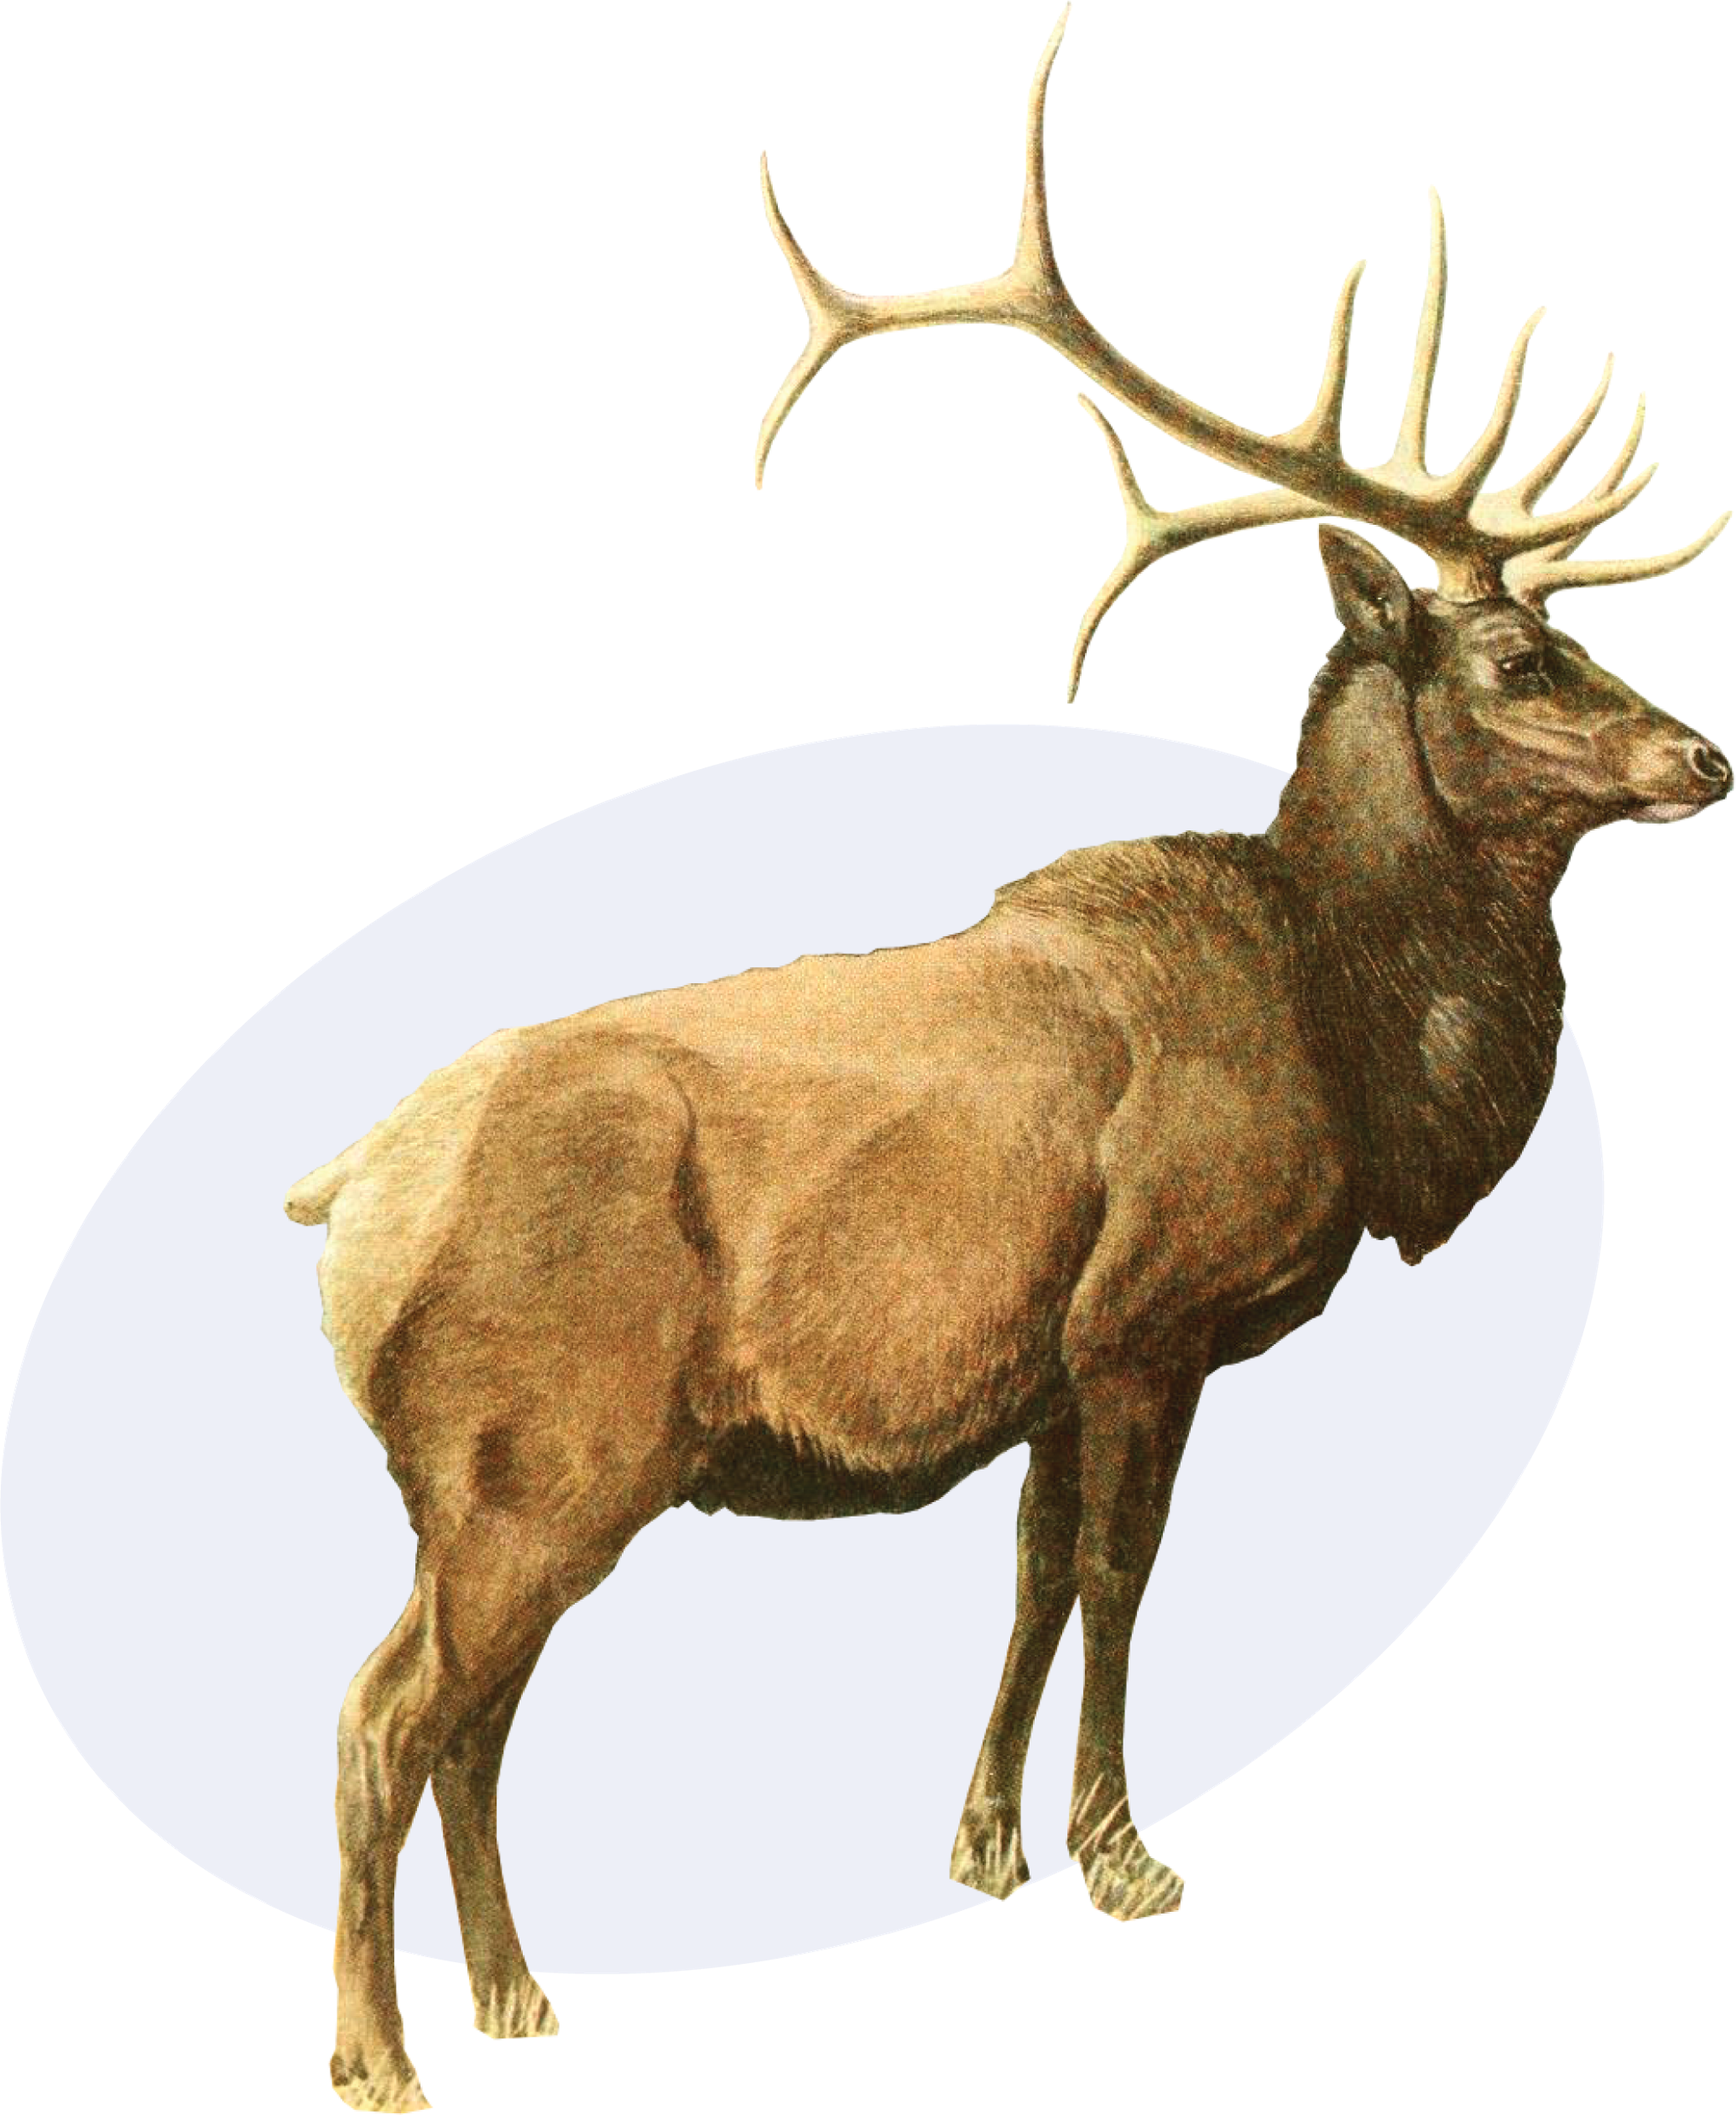
Invasive species
GBIF provides occurrence data that supports research, monitoring, and management of invasive species worldwide.
gbif.org/invasives
Notes:
Notes

Slide 3
Invasive species
The introduction of alien species to new ecosystems can have profound impacts on both biodiversity and human well-being when such species become invasive. GBIF is a vital resource for users seeking to discover, access, and use data on invasive species worldwide, providing a single entry point that can help bridge the gap between scientific knowledge and practical solutions to invasive species challenges.
By participating in the Inter-Agency Liaision Group on Invasive Alien Species and collaborating with expert communities like the International Union for Conservation of Nature (IUCN) and the Invasive Species Specialist Group (ISSG), GBIF fosters collaboration and knowledge-sharing across different disciplines and regions, playing a critical role in the global effort to manage invasive species and the achievement of global goals for biodiversity conservation and sustainable development.
gbif.org/invasives

Slide 4
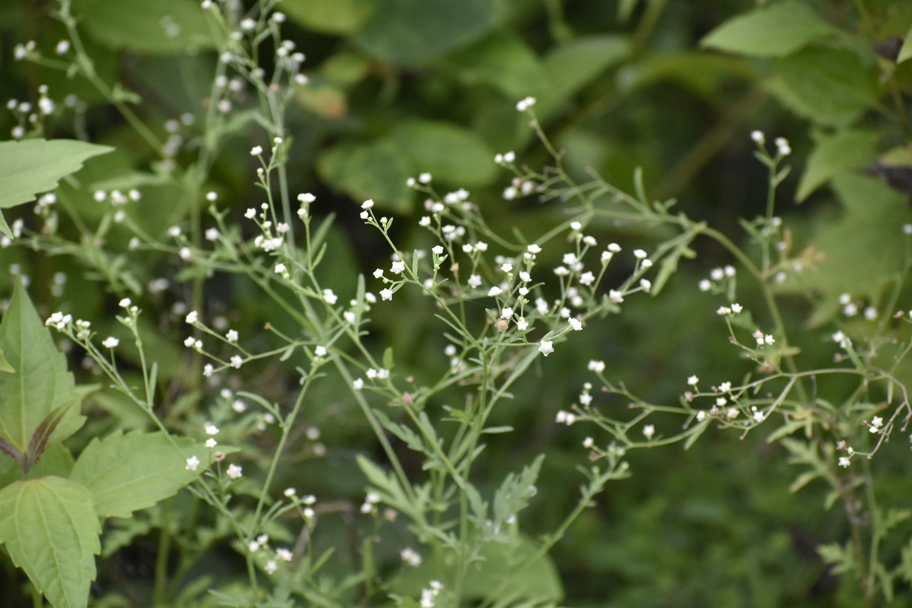
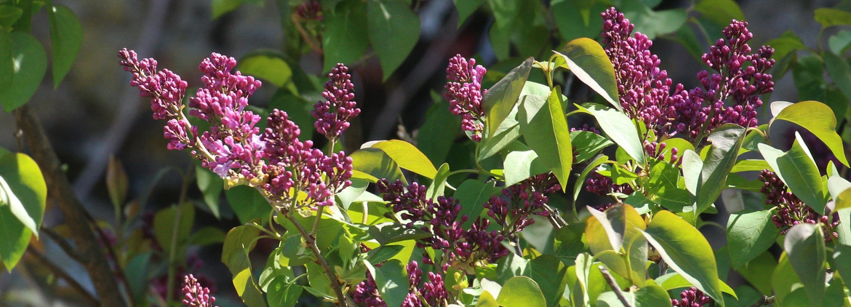
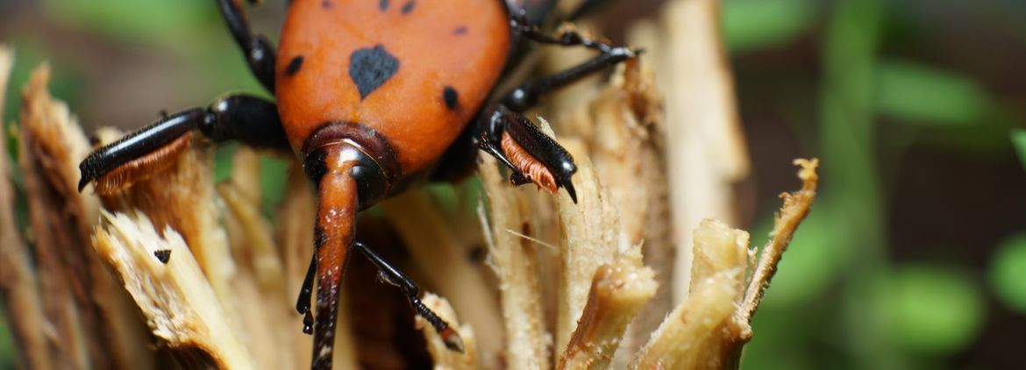
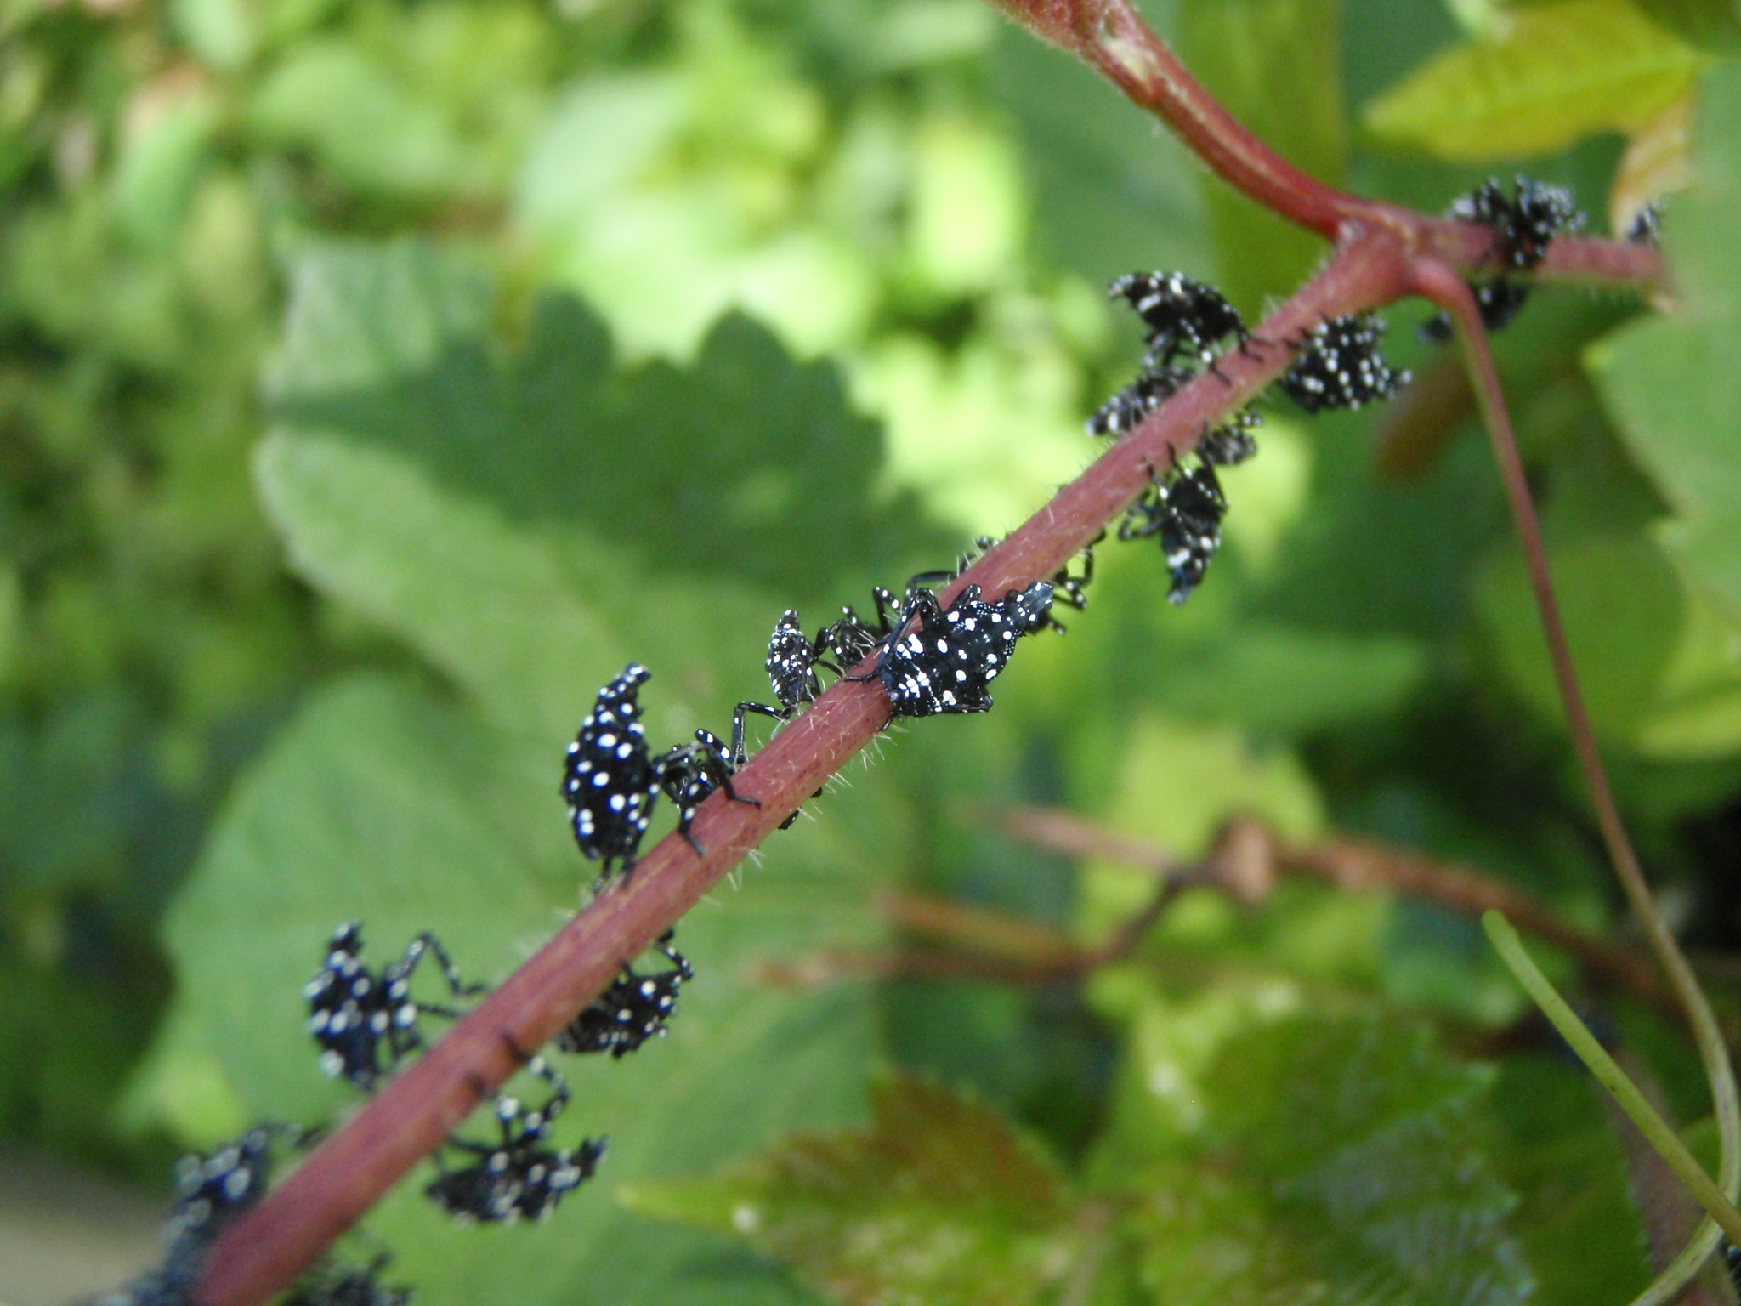
Featured data uses in invasive-related research
Factors influencing successful naturalization and invasion of alien plants in India
Anthropogenic habitat disturbances associated with human development determine botanical naturalization
Predicting hotspots for invasive species introduction in Europe
Spotted lanternfly planthopper: grape pest to disrupt the global wine market?
gbif.org/invasives
Notes:
Notes

Slide 5
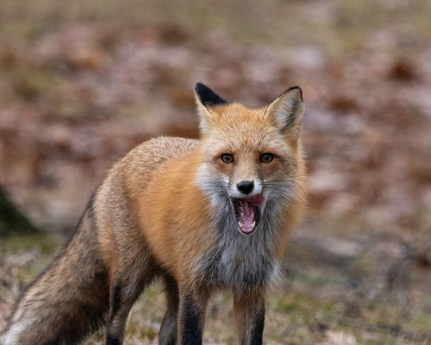
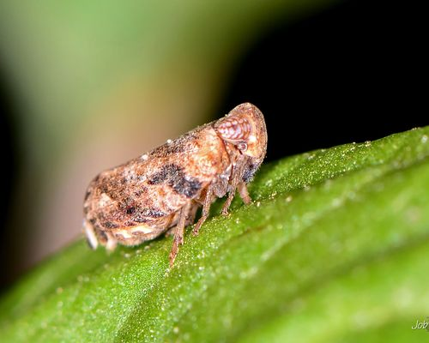
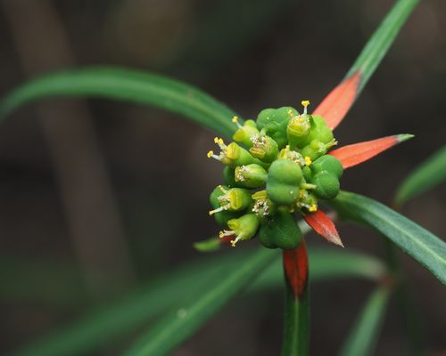
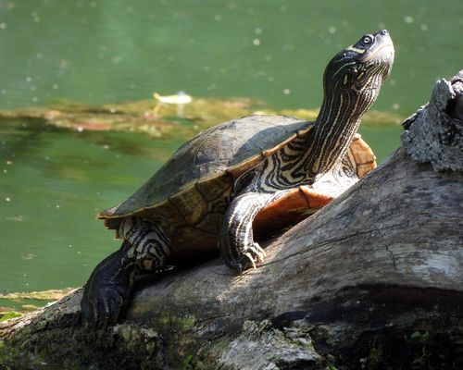
Featured datasets of invasive species related data
Global Invasive Species Database
Invasive Species Specialist Group ISSG
Global Register of Introduced and Invasive Species datasets
Invasive Species Specialist Group ISSG
Checklist of Invasive Plants in Cuba - 2022
Global Register of Introduced and Invasive Species - Belgium
gbif.org/invasives
Notes:
Notes

Slide 6

Invasive species
Learn more!
gbif.org/collections

